Slide 1


Video Games Sale Umesh Siddanagaiah

Slide 2

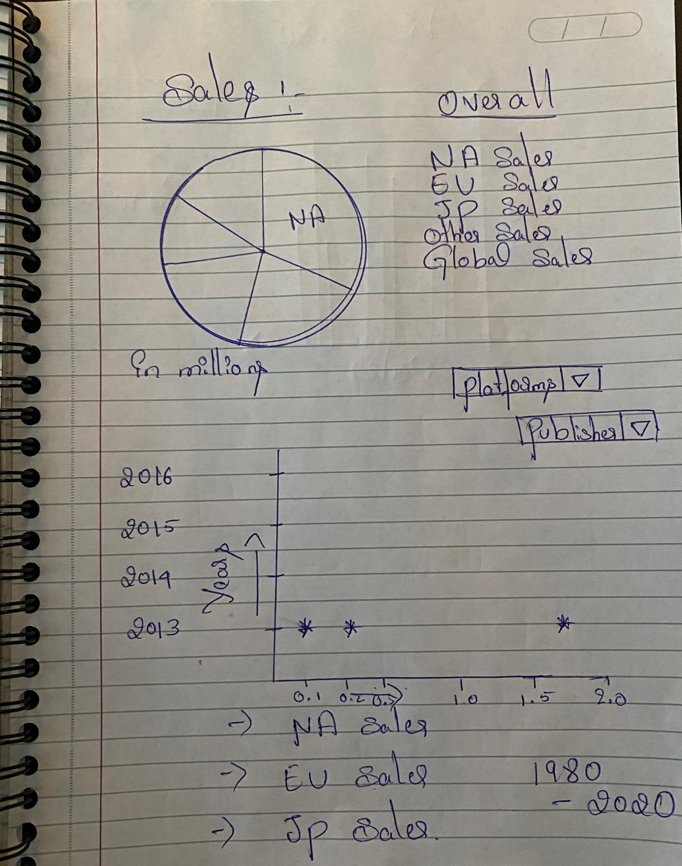

Slide 3
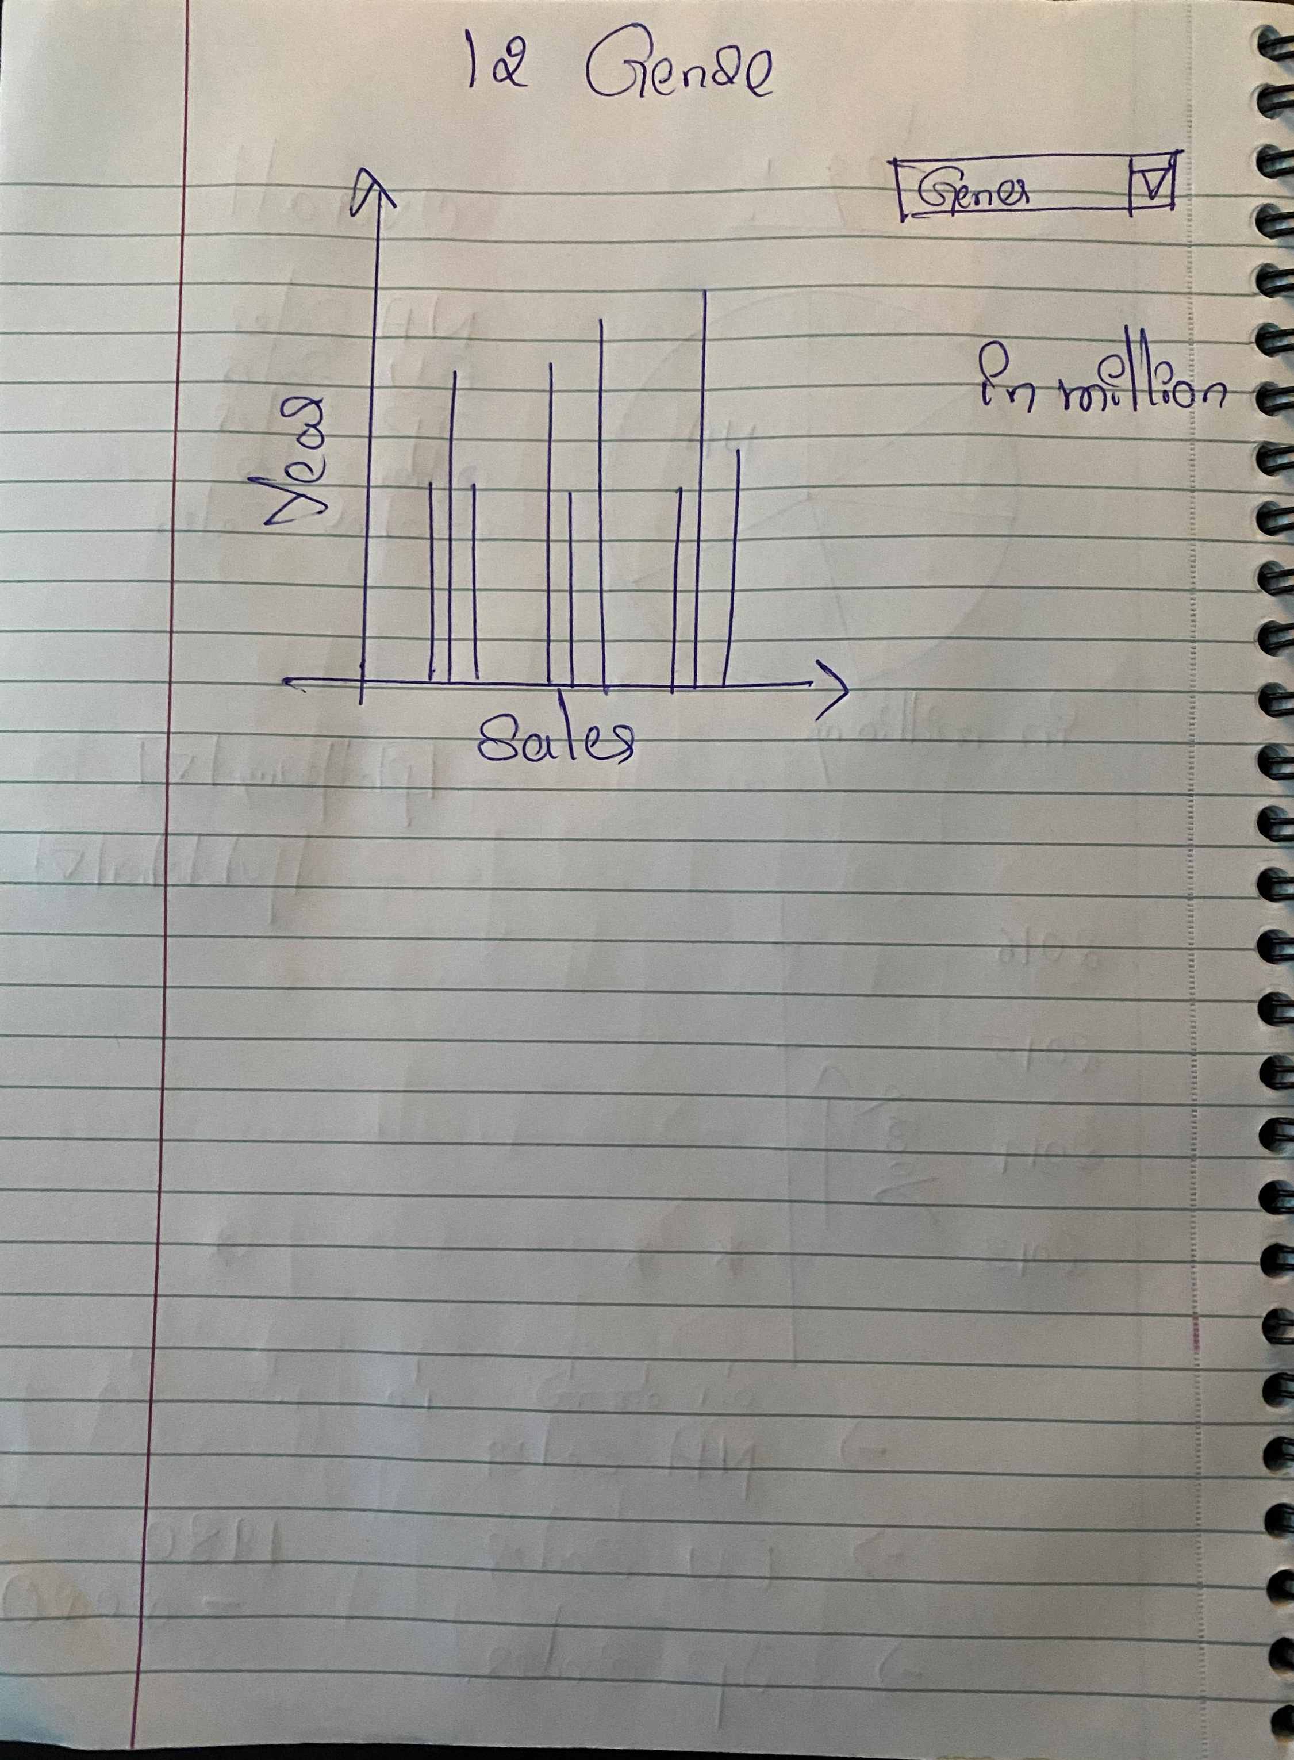

Slide 4

Thank you. Questions?

